Slide 1
Workbook Sales & Gross Profit (Planning)
Internal Use Only
April 2017
EXCEL FILE:

Slide 2
Disclaimer
The content of this workbook has been produced by KPMG Germany/Deal Advisory on the basis of German accounting standards and/or IFRS, as well as considering KPMG Germany’s firm and country requirements, regulations, processes, policies and best practices. Please check your local accounting and other requirements before applying the content.

Slide 3
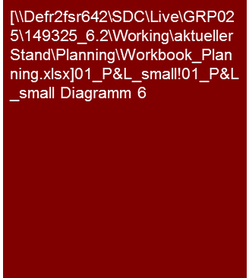
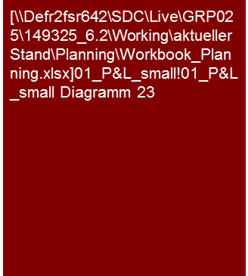
Overview (1/7) – Mission statement
Sales and Gross Profit (Planning)
Benchmarking Plus tool is available in Germany. Please ask for benchmarking options in your region.
Mission Statement:
The goal is the estimation of the plausibility of the planning of sales and gross profit on the basis of transparency of the major planning assumptions and their consistency with the past, market and competitive analysis
Customer situation
Definition/Methodology/Tools of the basis analysis
Buy Side/Sell Side/JV/Turnaround
Sales and gross profit planning as material initial parameters for the derivation of the cash flow and therefore material drivers for valuations, purchase price determination, assessment of the potential for restructuring
Analysis of the ambitiousness of the planning for negotiations, adjustments of purchase price (e.g. earn outs), internal transactions and tax purposes as well as assessment potential for restructuring
Cost of Sales (CoS): The earnings attained are compared to the expenses required for these.
Definition
Sales and gross profit are to be determined, in accordance last balance sheet/audited figures or on the basis of the definition of the Controlling/Management Reporting of the target. When applying the definition of the Controlling/Management Reporting of the target, the conversion to the balance sheet/audited financial information is to be assured.
Pay attention to comparability of the definition of sales and gross profit (e.g. net sales, capitalization options opex vs. capex) to competitors or market studies!
Methodology
Discussions with planning responsible persons
Transparent and consistent linking of the results of the competitive analysis from the past analysis and market and competitive analysis with planning analysis (generally also joint presentation)
Analysis and/or presentation at selected levels (e.g. group, legal entity, segment, profit center, product group, region, etc.) in accordance with the necessity, appropriateness and data situation in the specific case
Tools
Benchmarking Plus
EBIT and EBIT margin over time
Composition of expenses and expenses ratios
Degree of standardization
Linking of the past and planning as well as the market and competitive analysis
Determination and collection of sector-specific KPIs (e.g. Benchmarking Plus)

Slide 4
Overview (2/7) – Analysis puzzle
Sales and Gross Profit (Planning)
Market and competitive analysis^{(a)}
Market
Results of analysis
Core statement/Conclusive valuation
Planned/Actual comparison adherence to budget^{(c)}
Comparison
with
past
Comparison with market expectations
Value drivers
Investments and
Depreciation^{(d)}
Planning analysis expenditures & margins
Analysis of past^{(b)}
Scale effects
LTM
Normal- ization^{(e)}
Comparison
with
peers
Current
trading
Product/Segment/
Regions mix
effects
Cost savings potential & synergies^{(f)}
Peer group
Note: a) See Market Analysis workbook; b) see Expenses (CoS or TCM) workbooks; c) see Planning Process and Adherence to Planning workbook; d) see Investments (Planning) workbook; e) see Normalized Earnings workbook; f) see Synergy Management workbook
Scope of the workbooks

Slide 5
Overview (3/7) – Analysis tree
Sales and Gross Profit (Planning)
Analysis of sales growth and gross profit margins development
Definition
Total market
XXX AG
Region/Segment/ Product
Market share
Market growth
individual regions
segments/products
Share of sales
Gross profit margin
Region A
Market share Region A
Market growth Region A
Share of sales Region A
Gross profit margin Region A
Segment B
Market share Segment B
x
Market growth Segment B
x
Share of sales Segment B
x
Gross profit margin Segment B
Product C
Market share Product C
Market growth Product C
Share of sales Product C
Gross profit margin Product C
Total market
100 %
∑
100 %
Total sales
∑
Market growth
Gross profit margin XXX AG
Corporate specific market growth XXX AG
Comparison
Comparison
Expected gross profit margin of peer group
Planned growth
XXX AG
Expected growth of peer group

Slide 6
Overview (4/7) – Pitfalls
Sales and Gross Profit (Planning)
No. | Pitfalls/Lessons learned
 | Comparability: With the analysis of the past and planning as well as the benchmarking of the planning in the market and competitive environment/peer group, the general comparability of the parameters analyzed is to be assured, if necessary by means of adjustments/conversions. Differences may result, for instance, with: The delineation: Sales (correct delineation of e.g. regions, segments, products), growth rates (market growth vs. company-specific market growth) and gross margin (regional, segment, product mix differences) The information shown: Differing accounting standards or utilization of balancing options or latitude (e.g. reporting as expense vs. capitalization and depreciation, differing realization of sales, etc.) The fundamental design and arrangement of economically identical/similar issues: Various measures for achieving the same economic result (e.g. acquisition vs. leasing/rental, borrowing vs. factoring) A lack of complete comparability (e.g. lack of information about the impact of options, etc. with peers that appear to be material) is to be mentioned and appropriately recognized (e.g. “only limited validity“).
 | Planning depth: Frequently, the first planning year (budget) is detailed and therefore planned realistically or even conservatively because other processes are based on them (remuneration, metrics, target attainment) and measurement can be made promptly (current trading). Subsequent planning years are generally not included here and are frequently based on a reduced depth of the planning assumptions. They are often planned generally, frequently much “more fancifully” (higher growth, increase in margins, similar to a strategic outlook) and therefore should be viewed more critically.
 | Cyclical nature: In the past analysis there is frequently a clearly cyclical nature of the business model depending on the economic and product life cycles. In planning, these cycles are frequently neglected and a constant growth, increasing margins, etc. displayed. The planning is to be viewed critically in this regard.
 | Timing: Especially with growing companies a certain amount of time will pass between investment and the resulting positive contribution to value. The planning analysis must take this into consideration, especially with benchmarking.
 | Materiality: With the analysis of the past and planning as well as the benchmarking of the planning in the market and competitive environment/peer group, care should be taken that these are only performed for material products/product groups/segments/regions. In the assessment of the materiality it is better to base these on a margin parameter (e.g. gross profit) than a sales parameter. For instance, Product A represents 60% of the sales and 10% of the gross profit while Product B holds 40% of the sales and 90% of the gross profit → focus on Product B
1
2
3
4
5

Slide 7
Overview (5/7) – Pitfalls
Sales and Gross Profit (Planning)
No. | Pitfalls/Lessons learned
 | Evidence: What does management base its planning assumptions on? Were external studies or other such sources utilized or is the planning based solely on empirical values and assumptions? Were the measures for achieving the plan documented? A prior soundness of the planning depends on the breadth of the information and the basis of the assumptions.
 | Intention: Generally a more optimistic picture of the future developmental potential of the target is shown and positive aspects especially emphasized in the framework of sell-side clients. While for buy-side clients, planning is scrutinized, especially critically, and tends to be viewed pessimistically. In both cases, it may come to adjustments of the client planning, scenarios or references to these in our reports.
 | Conversion actual to plan: Frequently, the first planning year/budget is not based on audited results from the previous actual year, but rather on a forecast/extrapolation for the previous actual year. Frequently, the audited results and forecast/extrapolation for the previous actual year deviate from one another. Breaches may then occur between the previous actual year and first planning year/budget that may have to be adjusted in case of materiality (adjustment of planning, P&L and balance sheet).
6
7
8

Slide 8








Overview (6/7) – Core issues
Sales and Gross Profit (Planning)
Core Issue | Specific analysis | Page(s)
Is the sales planning consistent with market expectations? | Comparison of sales planning for expected market growth rates, market studies, size of entire market and market share, growth rates of peer group companies (benchmarking), economic growth rates (reasonable selection). Note: Assure a uniform definition of sales in market studies, peers and company! Identify, analyze and justify possible deviations Pay attention to the results of the past analyses with regard to dependency on general economy and seasonality of sales | 10-11
2. Which products/product groups/regions/segments have the greatest importance for sales/gross profit over time? | Analysis of the composition of sales and gross profit based on the actual situation in the planning period Prioritization of follow-up analyses on the basis of the importance of products/product groups/segments/regions for the gross profit (!) | 12-16
What issues have a major impact on the planned development of sales and gross profit? | Analysis of major drivers (e.g. price or volume effects, portfolio effects, regulatory changes, etc.), trends, outliers, breaks, etc. Have ramp-up effects for new products/regional expansion been considered? Presentation of like-for-like growth Conversion of last actual year to planning year(s) – e.g. waterfall chart | 17-18
Does the current order backlog support the expected sales? | Analysis of current order backlog and maturity till achievement of sales Note the results from the past analysis with regard to historical book-to-bill ratios to effective day | 19
Can the sales planning be achieved with the planned capacity? | Analysis of sales planning in relation to existing capacities (utilization) and to investment and material costs (external labor and maintenance) and personnel cost planning (own performance) | 20

Slide 9
Overview (7/7) – Core issues
Sales and Gross Profit (Planning)
Core Issue | Specific analysis | Page(s)
Is the gross profit margin comparable to that of the past and margins achieved by the peer group companies or other market data? | Comparison of gross profit margin to historical margins (in cases of fluctuating margins, check for dependencies e.g. economy, scale effects, shift of product mix, etc.) to analysts’ expectations and to peer group companies (Benchmarking – reasonable selection) Possibility of passing through price increases on the procurement end Analysis of gross profit per product group and possible shifts of product mix Identify, analyze and justify possible deviations | 21-23
Does the current trading/LTM or the current forecast support the sales and gross profit planning? | Comparison of current trading (if needed, extrapolation to entire year) or current forecast with sales and gross profit planning | 24-25
Do significant currency risks exist for the sales and gross profit planning? | Analysis of percentage of currency transactions on sales or gross profit Which exchange rates (current/fixed exchange rate vs. forecasted/ period-specific exchange rates) have been considered? Are there possible compensating currency opportunities at the level of the gross profit (natural hedge) | 26
In case of a transaction: What impacts do change-of-control (CoC) clauses have on material (long-term) customer or supplier contracts? | Examine existence of CoC clauses on the basis of legal DD or information from company Estimate the probability of the exercising of CoC clause and the possible impact on planning | 27

Slide 10
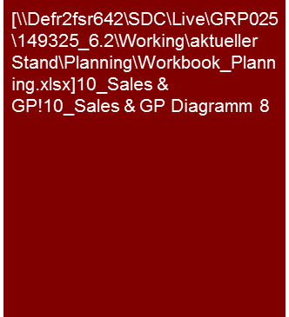
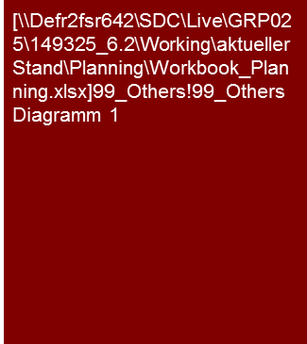
1. Is the sales planning consistent with market expectations? (1/2)
Sales and Gross Profit (Planning)
In view of the XXX/ [subsequently analyzed issues] we consider the higher planned sales growth of the XXX AG compared to market expectations to be in general plausible.
Market volumes and market growth
Company-specific market growth
Market study YYY forecasts an average growth of x.x% p.a. in the next three years in region ZZZ.
While it is expected that the most important sales markets for the XXX AG – the xxx markets – will have single-digit growth, the YYY study forecasts higher growth rates for the much smaller markets in northern and eastern Europe. The XXX AG is, however, not represented/poorly represented/XXX in these markets.
Taking into consideration the regional share of sales of the XXX AG, an expected average company-specific market growth of x.x% p.a. results for the XXX AG.
The sales growth reflected in the XXX AG planning calculations is above the company-specific market growth rate derived. This is justified by XXX.
Company-specific market growth is at 2.1%
XXX AG plans with a growth rate of 2.4%
Comparison XXX AG vs. entire market
Tools
Excel analysis

Slide 11
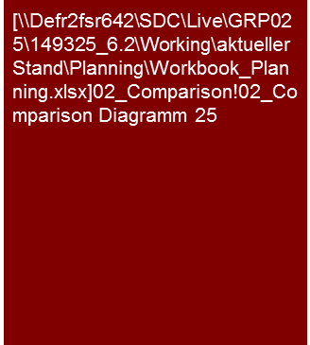
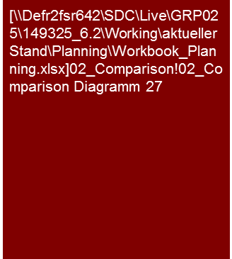
1. Is the sales planning consistent with market expectations? (2/2)
Sales and Gross Profit (Planning)
The XXX AG sales planning is plausible, in view of the market expectations as well as the analysts’ forecasts for XXX AG and its competitors.
As a result of xxx we agree with the management’s forecast regarding the higher growth prospects in Segment B compared to the average forecasts of the analysts.
Sales growth in comparison to peer group
Comparison of the sales growth to competitors and market studies
The expected sales growth of the XXX AG is within the range of expected sales growth for comparable companies.
While the expected sales growth for 2013 corresponds to the average sales growth of comparable companies, in the years 2014 and 2015 it is above the average of comparative companies due to the larger share of XXX AG in the strong growth region X compared to the competition.
[.... Comparison to market studies ....]
Comparison to analysts’ expectations
The XXX AG sales planning is in the range of analysts’ forecasts for the planning years under consideration.
While the analysts expect even higher growth than the XXX AG as a result of XXX in 2013, the XXX AG growth expectations for 2014 and 2015 are above the average sales expectations of the analysts. The primary reason for this is the different forecasts with regard to the growth prospects in Segment B. In our opinion…
The wide range of the analysts’ forecasts is noteworthy. While some analysts assume a decline in sales growth up to 2015, others expect a significant increase in sales growth. The primary reason for this is the varying forecasts of the chances of success for the introduction of Product X in 2013. In our opinion…
Sales growth in comparison to analysts' expectations
If applicable presentation of sales planning at segment level
Tools
Excel analysis

Slide 12

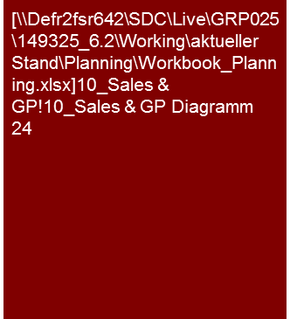
2. Which products/product groups/regions/segments have the greatest importance for sales/gross profit over time? (1/2)
Sales and Gross Profit (Planning)
As a result of the, in our opinion, realistic forecasts of the management regarding the market launch of XX (Segment B) in 2013 it is plausible that the XXX AG sales growth is above that of the past and above market expectations.
Additional sales growth In Segment B will lead to significant shifts in the product mix in the planning period.
Sales development according to segments
Sales
The XXX AG currently obtains about half of their sales in Segment A. This segment will remain the largest sales contributor in the course of the planning. Segments B and D contribute only X% or X% to total sales at the beginning of the planning period.
The XXX AG expects to increase its average sales growth in the next few years compared to the past from X% to X% and therefore is above/below the segment-weighted market growth of X% in the planning period. The causes for this are xxx and xxx in segments A and B.
[.... Details on material aspects of segments A and C ....]
As a result of the expected average sales growth of X% in Segment B, the product mix will shift significantly with simultaneous negative growth expectations in Segment D as a result of xxx. Material growth driver in Segment B is the launch of Product XX in 2013, whereby the decline in Segment D should be significantly overcompensated.
Actual
Plan
Sales growth according to segments
Tools
Excel analysis

Slide 13

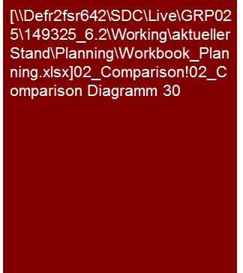
2. Which products/product groups/regions/segments have the greatest importance for sales/gross profit over time? (2/2)
Sales and Gross Profit (Planning)
The primary contribution to the gross profit of the XXX AG is provided by segments A and C in the entire period of the analysis.
As a result of the expected increase in sales and the associated scale effects, at the end of the planning horizon, Segment B will also provide a significant contribution to the XXX AG gross profit
The expected increase in the margin at the group level follows plausibly from the planned shifts of the product mix.
Development of the gross profit according to segments
Gross profit and gross profit margin
Segments A and C provide the major contribution to the XXX AG gross profit. While this is attributable to high sales for Segment A, for Segment C, in which the XXX AG service business is bundled, the high gross profit margin is the cause.
A, for the most part, stable gross profit margin is expected for Segment A in the planning period. Expected cost increases in raw material should be passed on completely to the customers.
An increase of the gross profit margin is expected in the planning period for Segment C. A reduction of the manufacturing costs will be achieved by an optimization of the production processes in Plant X.
Along with a significant increase in sales, a significant increase of the gross profit margin is expected for Segment B. The reason for this is major savings in purchasing as a result of the increased procurement volumes.
Segment D is of minor importance for the development of the gross profit.
Actual
Plan
Sales/Gross profit margin according to segments
Tools
Excel analysis

Slide 14


2. Which products/product groups/regions/segments have the greatest importance for sales/gross profit over time? (1/3) (Alternative)
Sales and Gross Profit (Planning)
The primary contribution to the gross profit of the XXX AG is provided by segments A and C in the entire period of the analysis.
As a result of the expected increase in sales and the associated scale effects, at the end of the planning horizon, Segment B will also provide a significant contribution to the XXX AG gross profit
The expected increase in the margin at the group level follows plausibly from the planned shifts of the product mix.
Gross profit and gross profit margin
Gross profit and gross profit margin
Segments A and C provide the major contribution to the XXX AG gross profit. While this is attributable to high sales for Segment A, for Segment C, in which the XXX AG service business is bundled, the high gross profit margin is the cause.
A, for the most part, stable gross profit margin is expected for Segment A in the planning period. Expected cost increases in raw material should be passed on completely to the customers.
An increase of the gross profit margin is expected in the planning period for Segment C. A reduction of the manufacturing costs will be achieved by an optimization of the production processes in Plant X.
Along with a significant increase in sales, a significant increase of the gross profit margin is expected for Segment B. The reason for this is major savings in purchasing as a result of the increased procurement volumes.
Segment D is of minor importance for the development of the gross profit.
Actual
Plan
Alternative presentation:
Gross profit and margin over time
For purposes of readability the graph can be used if necessary for supplementing figures.
CAGR Sales/ø Gross profit margin (3 years) according to segments
Alternative presentation:
Average sales growth instead of sales
Tools
Excel analysis

Slide 15


2. Which products/product groups/regions/segments have the greatest importance for sales/gross profit over time? (2/3) (Alternative)
Sales and Gross Profit (Planning)
The primary contribution to the gross profit of the XXX AG is provided by segments A and C in the entire period of the analysis.
As a result of the expected increase in sales and the associated scale effects, at the end of the planning horizon, Segment B will also provide a significant contribution to the XXX AG gross profit
The expected increase in the margin at the group level follows plausibly from the planned shifts of the product mix.
Composition of gross profit margin according to segments
Gross profit and gross profit margin
Segments A and C provide the major contribution to the XXX AG gross profit. While this is attributable to high sales for Segment A, for Segment C, in which the XXX AG service business is bundled, the high gross profit margin is the cause.
A, for the most part, stable gross profit margin is expected for Segment A in the planning period. Expected cost increases in raw material should be passed on completely to the customers.
An increase of the gross profit margin is expected in the planning period for Segment C. A reduction of the manufacturing costs will be achieved by an optimization of the production processes in Plant X.
Along with a significant increase in sales, a significant increase of the gross profit margin is expected for Segment B. The reason for this is major savings in purchasing as a result of the increased procurement volumes.
[... Segment D ….]
Actual
Plan
Alternative presentation:
Composition of the gross profit margin instead of the gross profit (abs.)
Share of sales/Gross profit margin according to segments
Tools
Excel analysis
Alternative presentation:
Share of sales of the individual segments and gross profit margin

Slide 16


2. Which products/product groups/regions/segments have the greatest importance for sales/gross profit over time? (3/3) (Alternative)
Sales and Gross Profit (Planning)
The primary contribution to the gross profits of the XXX AG over the entire analysis period was made by the Region X, Segment X,…
An expansion of the business with Customer X is planned in the period of analysis. This will lead to an increased importance of the Region Germany, Product B and wholesale.
Distribution of sales 2012
Distribution of sales
XXX
Alternative presentation:
Distribution of sales according to region, product, segment, customer, network
Distribution of sales 2015
Tools
Excel analysis

Slide 17

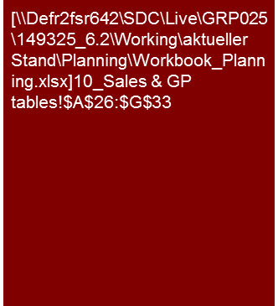
3. What issues have a material impact on the planned development of sales and gross profit? (1/2)
Sales and Gross Profit (Planning)
Primary driver for the sales increase of €xxx.x million in the planning period is the launch of Product B in 2013. This should lead to a cumulative increase in sales of €x.x million in the planning period and equals ca. X% of the entire expected increase in sales.
As a result of the expected product launch, the sales growth will subsequently be above the overall market.
Sales drivers in the planning period
Primary drivers of future sales development
Following the approval of Product B, the XXX AG intends to launch this product worldwide. Product B improves…
From the launch of Product B a cumulative sales increase of €xxx.x million is expected in the planning period.
In addition, expected price increases in Segment C are a material driver for the sales increase. Here, the XXX AG expects, as a result of bottlenecks in supply, due to the withdrawal of Competitor YYY from the market and unchanged demand, to be able to realize price increases.
Furthermore, the expansion of the XXX AG in Region Y with €xx.x million, is a material contribution to growth.
If applicable presentation at the segment level, or such
Tools
Excel analysis

Slide 18
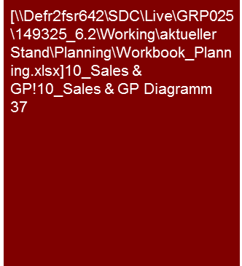
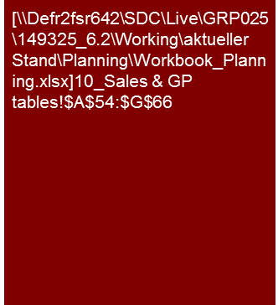
3. What issues have a material impact on the planned development of sales and gross profit? (2/2)
Sales and Gross Profit (Planning)
Primary drivers for the increase in gross profit of €xxx.x million in the planning period are the product launch in Segment B as well as the improvement in margins in Segment C as a result of expected price increases.
We consider the increase in the gross profit margin for the planning period to be plausible in general, taking the individual measures planned into consideration.
Drivers of gross profit in the planning period
Development of gross profit and gross profit margin
The increase of the gross profit margin is primarily attributable to XXX.
Along with that XXX is contributing to the increase in the gross profit.
XXX has a compensating effect …
If applicable presentation at the segment level, or such
Tools
Excel analysis

Slide 19

4. Does the current order backlog support the expected sales?
Sales and Gross Profit (Planning)
In view of the current order backlog the sales planning of the XXX AG appears ambitious and achievable only with a marked recovery of the entire economic environment.
Development of order backlog and sales
Analysis of order backlog
As of 31 December 2012 the XXX AG has an order backlog of €xxx.x million. This is for …(customers, products,…)
Ca. two-thirds of the order backlog will lead to realization of sales in 2013.
The planned sales for 2013 of €xxx.x million is therefore supported to X% by the order backlog. This is below the figure for the past and reflects the currently weak business environment.
If applicable presentation at the segment level, or such
Tools
Excel analysis

Slide 20

5. Can the sales planning be achieved with the planned capacity?
Sales and Gross Profit (Planning)
The XXX AG is increasing the utilization of its plants in the planning period to 85% and therefore achieving a technical full-capacity.
Additional increases in production volumes can only be achieved by an expansion of capacity or through increases in productivity resulting from improved technical processes.
Production volume and degree of utilization
[.... Description of development of capacity and utilization ....]
[.... Description of investment planning ....]
Actual
Plan
If applicable presentation at the segment level, or such
Tools
Excel analysis

Slide 21


6. Is the gross profit margin comparable to that of the past and margins achieved by the peer group companies or other market data? (1/3)
Sales and Gross Profit (Planning)
The expected gross profit margin of the XXX AG is above the average margin of comparable companies due to scale effects.
As a result of the size of the XXX AG we consider the planned scale effects to be realizable.
Gross profit margin in comparison to peer group
Comparison of gross profit margin
The expected gross profit margin of the XXX AG is within the range of the margins of comparable companies and above the average of the peer group.
The above-average gross profit margin is primarily attributable to scale effects/purchasing advantages/XXX. Larger companies are in a position to achieve a higher gross profit margin.
As a result of the increasing scale effects/purchasing advantages/XXX in the course of planning, the distance of the XXX AG gross profit margin to that of the peer group average increases in the course of planning.
CAGR Sales/ø Gross profit margin (3 years) in comparison to peer group
If applicable presentation at the segment level, or such
Tools
Excel analysis

Slide 22

6. Is the gross profit margin comparable to that of the past and margins achieved by the peer group companies or other market data? (2/3)
Sales and Gross Profit (Planning)
Based on the comparison of analysts’ forecasts, the expected XXX AG gross profit margin appears ambitious.
Gross profit margin in comparison to analysts' expectations
Comparison of gross profit margin
The expected gross profits of the XXX AG are in the upper third of the analysts’ forecasts for the planning years.
...
If applicable presentation at the segment level, or such
Tools
Excel analysis

Slide 23

6. Is the gross profit margin comparable to that of the past and margins achieved by the peer group companies or other market data? (3/3)
Sales and Gross Profit (Planning)
The expected increase of the gross profit margin is primarily impacted by a reduction of the unit costs resulting from fixed cost digression.
Development of unit cost
XXX
XXX
Actual
Plan
If applicable presentation at the segment level, or such
Tools
Excel analysis

Slide 24
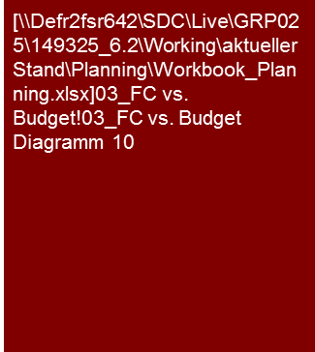
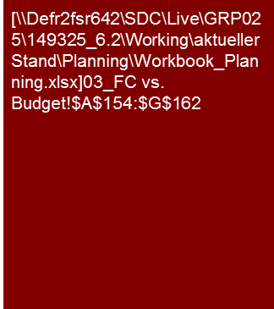
7. Does the current trading/LTM or the current forecast support the sales and gross profit planning? (1/2)
Sales and Gross Profit (Planning)
XXX AG achieved half of the budget in the first six months of the year 2013. The degree of budget achievement for the first six months was comparable to the level of the previous year.
YTD June 2013
XXX
XXX
If applicable presentation at the segment level, or such
Tools
Excel analysis

Slide 25
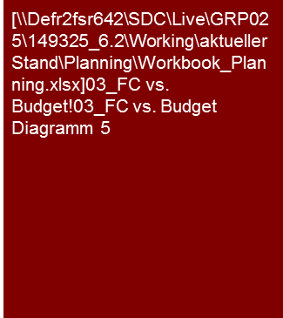
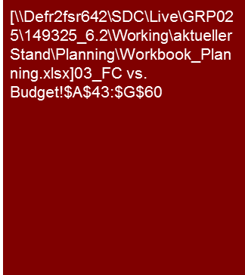
7. Does the current trading/LTM or the current forecast support the sales and gross profit planning? (2/2)
Sales and Gross Profit (Planning)
In view of the current business development, the 2013 budget appears very ambitious.
The current forecast reflects a deviation below plan for 2013.
No subsequent impacts for the further planning years are expected.
Comparison forecast vs. budget
Current business development
The current business development in the first half of 2013 is below the expectations of XXX AG. This is primarily attributable to XXX.
The current business development, which is below expectations, reflects the adjusted forecast, which is below budget. The expected sales are now €x.x million or ca. X% and the EBITDA ca. €x.x million or ca. X% below budget.
Along with the business development, personnel costs above expectations in the forecast of the EBITDA are to be noted. These are due to an early conclusion of a collective bargaining agreement and encumbrances from litigation XXX.
The XXX AG management does not foresee any subsequent impact for the planning years 2014 and 2015 in the failure to make the budget in planning year 2013. We agree with this estimation on the basis of the information provided to us and the analyses we conducted.
Tools
Excel analysis

Slide 26
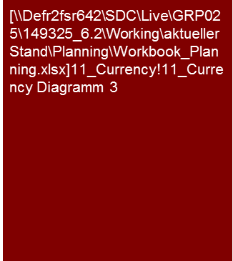


8. Do material currency risks exist for the sales and gross profit planning?
Sales and Gross Profit (Planning)
There is a material currency risk for the XXX AG with respect to the US dollar.
The exchange rate assumed in the planning appears appropriate in view of the current market data.
Sales earnings 2012
Expenses 2012
Currency risks
The XXX AG conducts about two-thirds of its business in euros and about one-third in US dollars.
The expenses of the XXX AG are in a comparable ratio.
While there is a major currency risk at the level of sales, due to the material share of the business conducted in dollars, the currency risk is lower at the profit level due to the compensating effects of the expenses.
The planning of the XXX AG is based on a plan exchange rate of XXX USD/EUR in the entire planning period. This appears appropriate in view of the current market expectations for the USD/EUR exchange rates.
Plan vs. forward exchange rate USD/EUR
Tools
Excel analysis

Slide 27

9. In case of a transaction: What impacts do change-of-control (CoC) clauses have on material (long-term) customer or supplier contracts?
Sales and Gross Profit (Planning)
The impact of contracts with change-of-control clauses on the XXX AG planning appears to be slight.
Share of customer contracts with CoC clauses
Change-of-control clauses
The XXX AG basically has five customer contracts that contain a change-of-control contract.
The share of sales in these contracts is ca. 20% in 2012 and decreases to 10% in the course of planning.
To date no talks have been held regarding the execution or discontinuation of the change-of-control clauses. The management estimates the probability of an exercising of the clause as being slight.
Supplier contract with a change-of-control clause do not exist.
Actual
Plan
Tools
Excel analysis

Slide 28
© 2017 KPMG International Cooperative (“KPMG International”). KPMG International provides no client services and is a Swiss entity with which the independent member firms of the KPMG network are affiliated.

